Slide 1
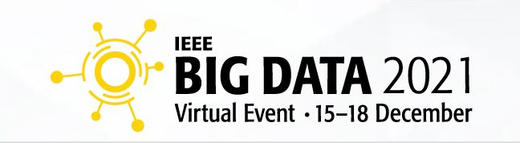

Slide 2


General Information
Underline is the virtual event platform used to support this year’s IEEE Big Data conference.
If you are a presenter, a pre-recorded video presentation is required.
All pre-recorded presentations must be uploaded to Underline by 24 November 2021.
The Presenter Submission Form detailed on page 9 must be completed by 24 November 2021.
On the following pages you can find a simple set of guidelines as well as a link to a third party software that you are welcome to use to record your presentation. We chose it because it is easy to use, and it has some powerful features that you are welcome to explore.
Should you have any questions or need additional support, please email, BIGDATA2021@underline.io

Slide 3
Overview
In this document you will find instructions on how to create your video presentation:
Step 1: Prepare the presentation and environment
Step 2: Download software & record your video presentation
Step 3: Complete the Presenter Submission Form (see link on page 9)
Should you have any questions or need additional support, please email BIGDATA2021@underline.io

Slide 4

1. Prepare Presentation & Environment
Use as quiet an area as possible. Avoid any sound distractions in the room where you record; avoid background music, sounds from roads, sounds from other rooms. Turn off the sound and notifications on your phone and computer.
On Windows 10 go to ‘Focus Assist’ and turn it to ‘alarms only’ for the recording.

Slide 5
Backdrop & Attire
Try to create a professional atmosphere.
An all-white background works well (i.e., a white wall).
A bookcase in the background works well.
Please keep in mind that appearance affects the presentation effectiveness.

Slide 6
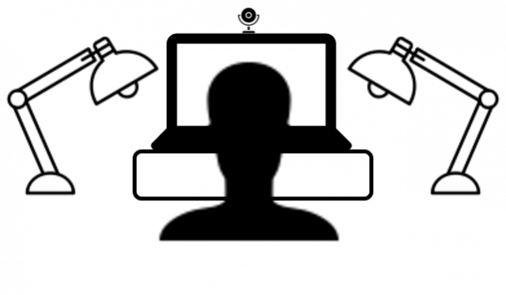
Lighting
When you record, your light source should be in front of you.
Avoid windows streaming in daylight, or an overhead fixture that may be behind you.
The best light source for recording is indirect natural light so if it is possible, record facing a window.
General rules for artificial light sources:
You do not want the light in the camera frame.
The light should not be too close to your face.

Slide 7
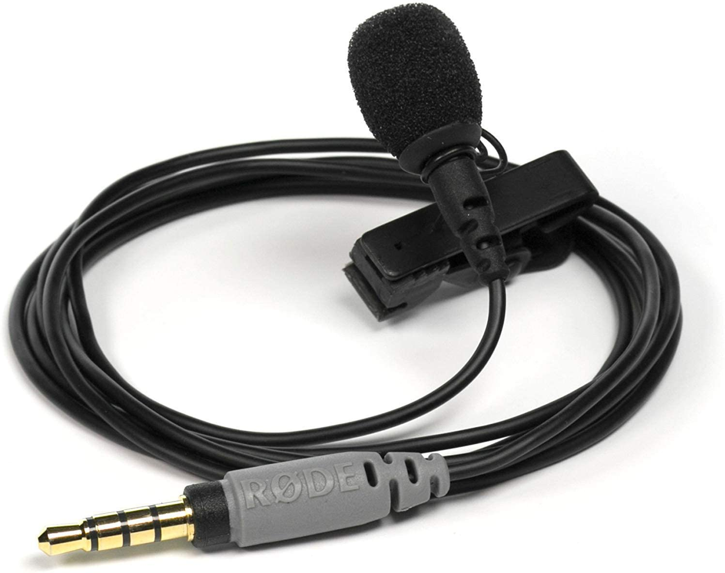
Audio
Having a dedicated microphone will improve audio quality.
Try to avoid using built-in microphones on your computer, if possible.

Slide 8
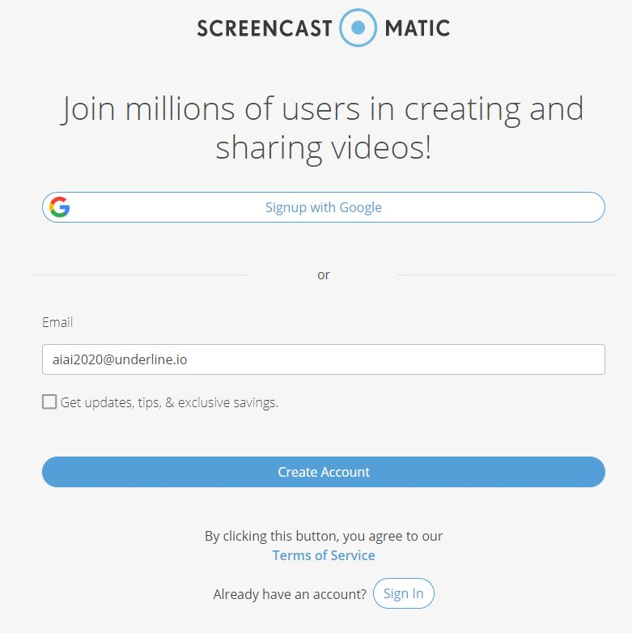
2. Download the Software & Record
Watch the “how to” video first:
https://www.youtube.com/watch?v=SJEcbkDfq-Y
Alternative “how to” video for those who can not access Youtube:
https://underline.vids.io/videos/ac9cd7bc1c1ee5c625/remote-recording-instructions-june-2020-mp4
After you view the video, access the Screencast-o-matic recording app on this link:
https://screencast-o-matic.com/register?ph=cYewir6zd
Important: Please use the above link install Screencast-o-matic. This will give you access to pro editing features and will store your video on our server.

Slide 9
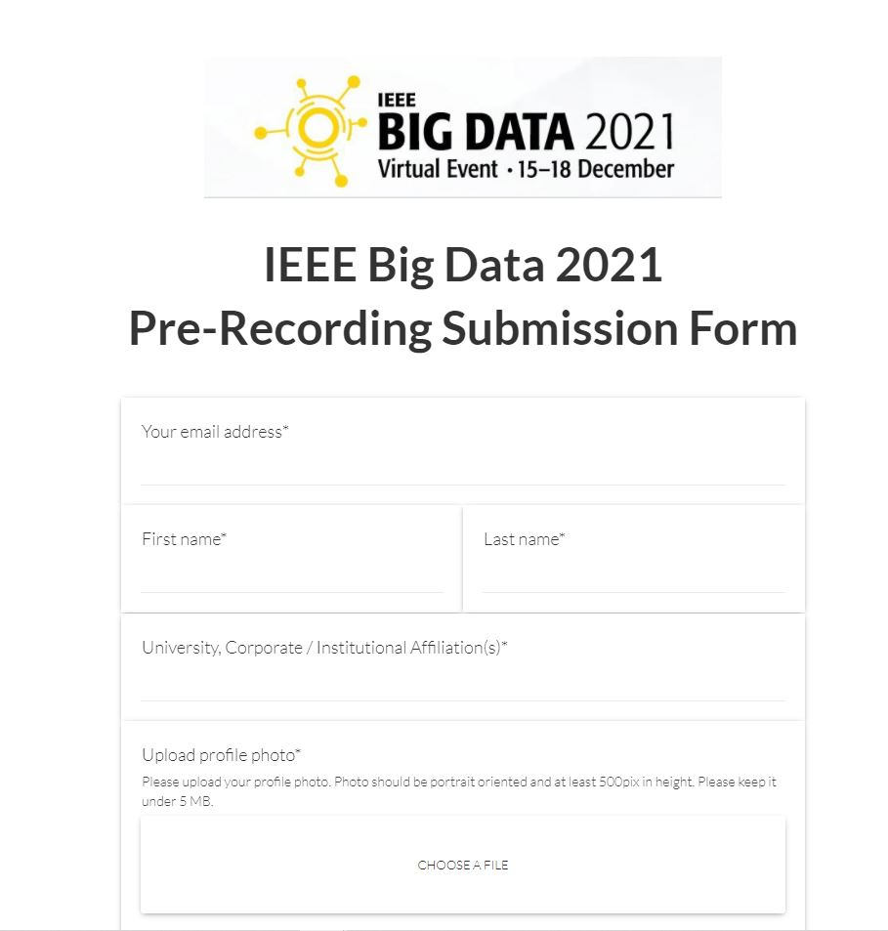
3. Submit Presentation Information
Please complete your presenter information and upload your video presentation by 24 November 2021:
https://ieeebigdata2021videosubmission.paperform.co/
Please prepare the information below prior to uploading your video presentation. Enter your information as it appears in the submission site:
Presentation Title
Profile Photo
Presenter Bio
Presentation ID
Brief Abstract (45-word maximum)
If you need to make edits to your presentation title, abstract, etc., please contact BIGDATA2021@underline.io for assistance.

Slide 10
FAQ Information
Q: Do I have to use Screencast-o-matic?
A: It is not necessary to record with our recommended software (Screencast-o-matic). If you are already used to a preferred recording software you are welcome to use it. In this case please attach your recording to the form provided in the instructions. Files of up to 1GB can be attached to the form. Please export the video to any of the major formats like mp4, avi, mov or m4v.
Q: When I click on the "Launch Recorder" a download was initiated. It wasn't a web recorder.
A: Yes, small recorder file needs to be downloaded. It's 300kb file. It actually records on your local machine for the
quality reasons / so we're not dependent on someone’s internet connection.
Q: Is there a limitation is screen size. For example, my screen is 1440p. Does that matter? Is it ok to record in 4k?
A: No limitations for recording. It can be recorded in 4k. However broadcast quality on Underline is max full HD / 1920p
Q: Is there a preference for where the webcam is during the presentation? Bottom right? Top right?
A: No preference, it can be moved. It is in bottom right by default so that's what's usually used.
Q: Is it ok for the authors to use the drawing tools? Does that normally work well?
A: Yes, if they want to. They can easily add this also after the recording (editor is included).
Q: Is there a way to adjust the webcam size. I can only seem to get full screen.
A: You can adjust the size and position after you recorded, in the editor.
Screencast-o-matic does not work on Linux systems. In case that you are using Linux we recommend recording with OBS (https://obsproject.com/). Contact us for help if you are recording on Linux.

Slide 11
For additional support and guidance,
please contact:
BIGDATA2021@underline.io

